Slide 1
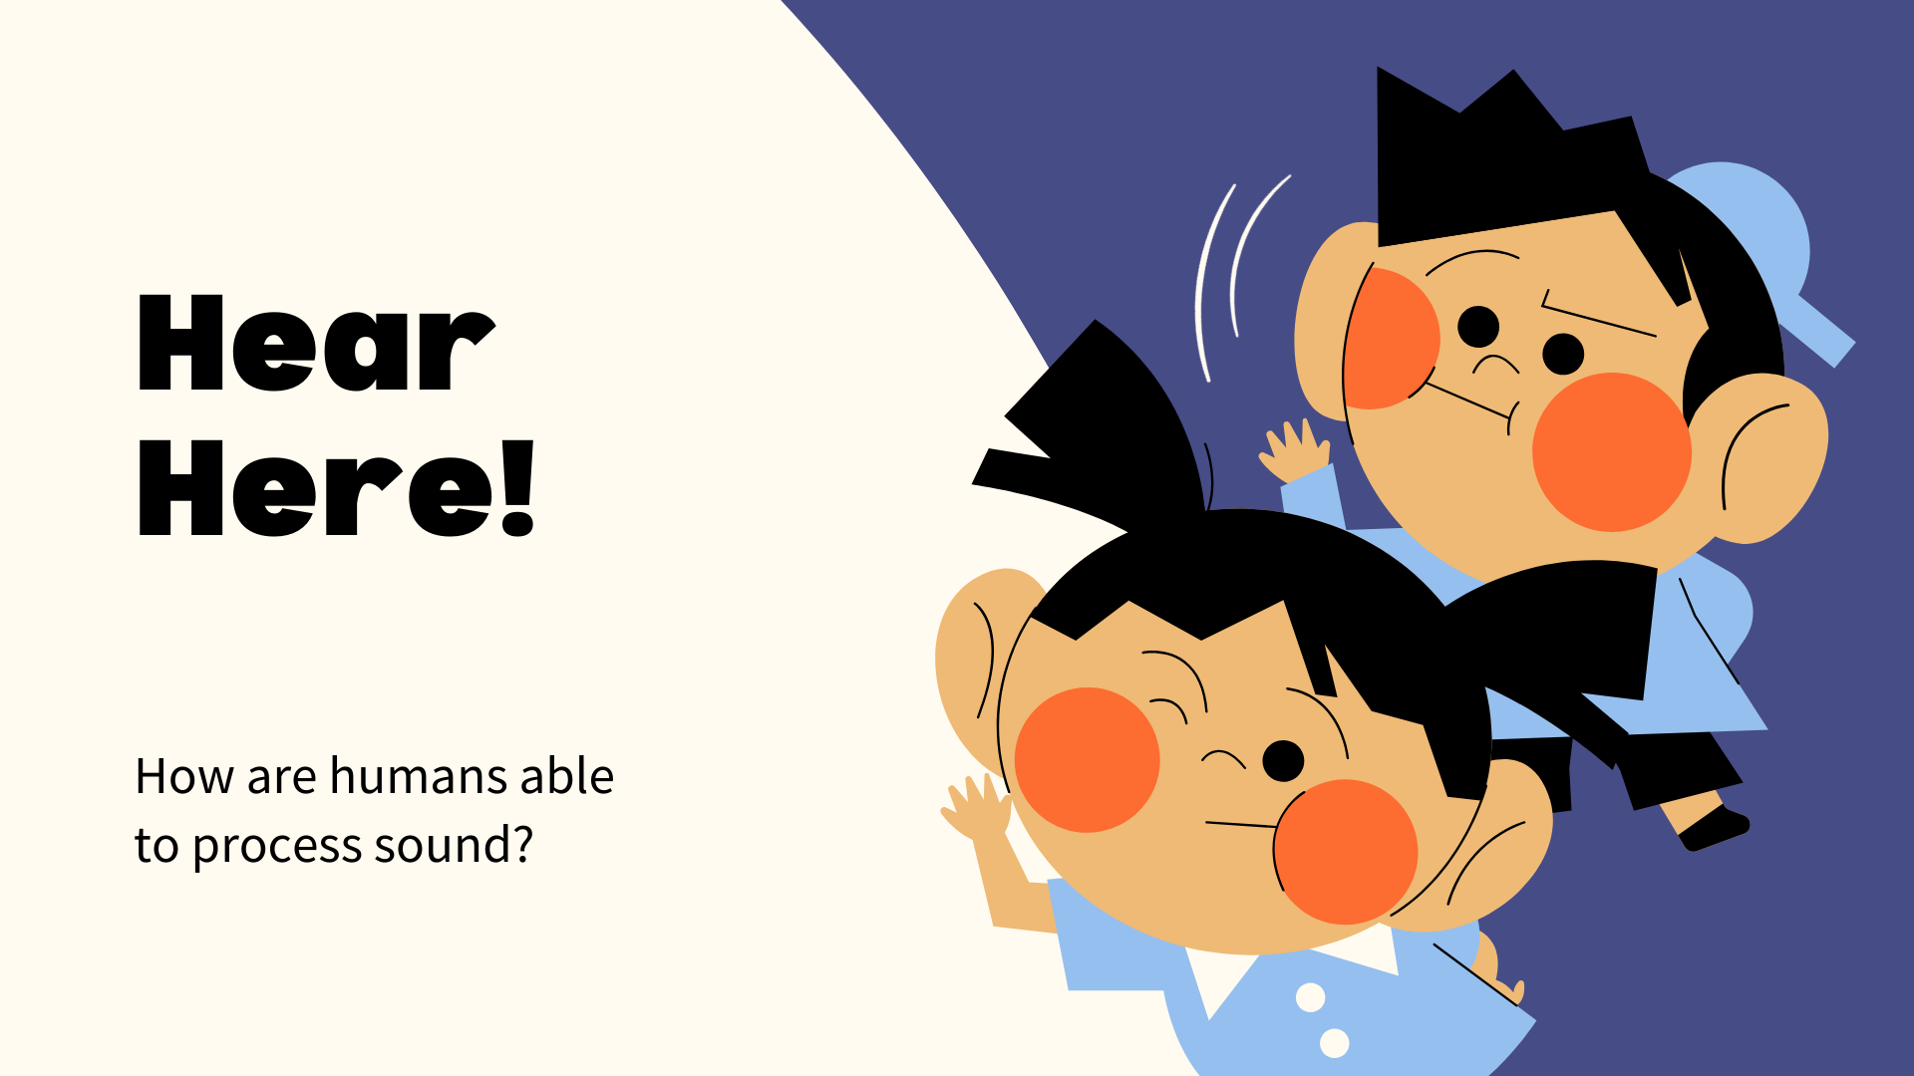

Slide 2
Imagine the tunes from a hummingbird high up in the sky.
The bird is far away, but we still know which direction to look up at.
How does our brain know where the sound is coming from?

Slide 3
Humans are very good at localizing sound!
Try this fun demo and put your ears to the test!
Do you feel like you are actually getting a haircut?

Slide 4
Humans are very good at localizing sound!
Try this fun demo and put your ears to the test!
Do you feel like you are actually getting a haircut?

Slide 5
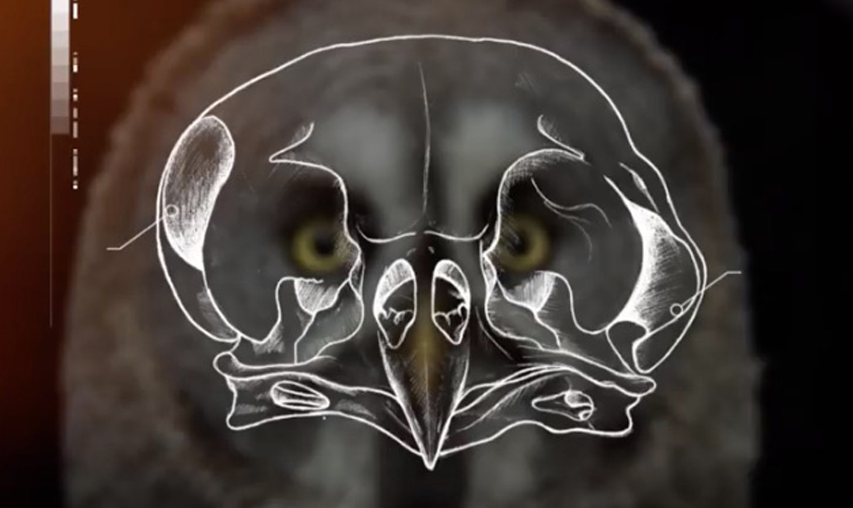
How does this illusion work?
Sound will arrive first at whichever ear it is closest to. Your brain calculates the difference between when each ear hears a sound to figure out exactly where the sound is coming from!
Right ear
Owls, which have remarkable hearing that allows them to find food in the dark, have one ear higher than the other. This helps them locate the source of sounds even better!
Left ear

Slide 6
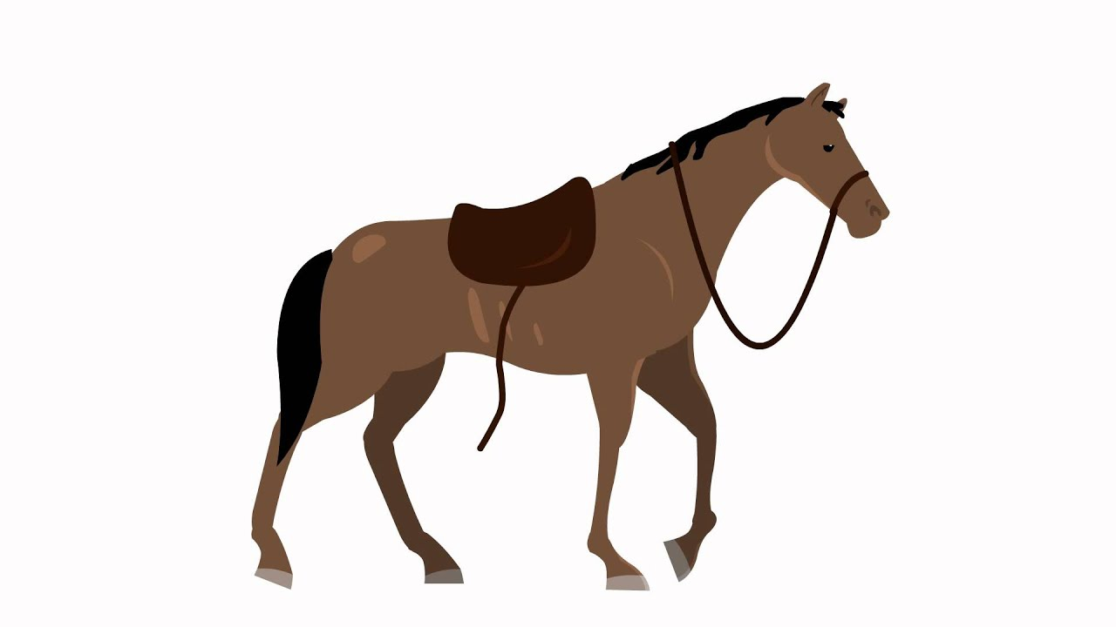
Why do some animals sound so different from each other?
Frog: audio
Horse: audio
Killer Whale: audio
House sparrow: audio

Slide 7
Why do some animals sound so different from each other?

Slide 8
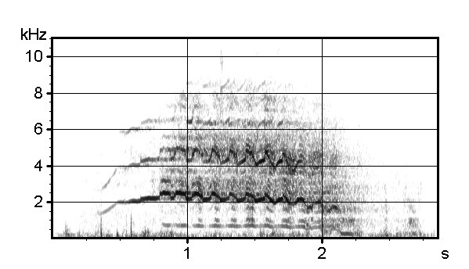
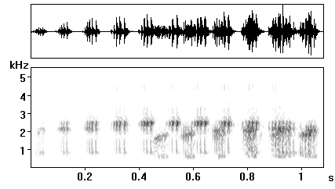
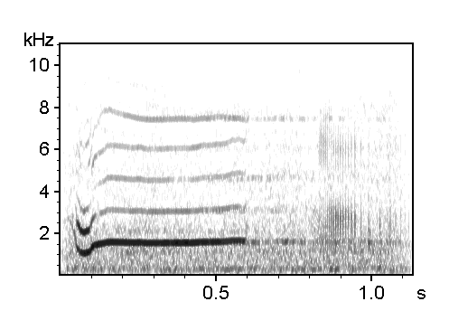
Each species has a distinct vocal sound wave, which can be seen through spectrograms.
Frog: audio
Horse: audio
Killer Whale: audio
House sparrow: audio

Slide 9
Each species has a distinct vocal sound wave, which can be seen through spectrograms.
Frog:
Horse:
Killer Whale:
House sparrow:

Slide 10
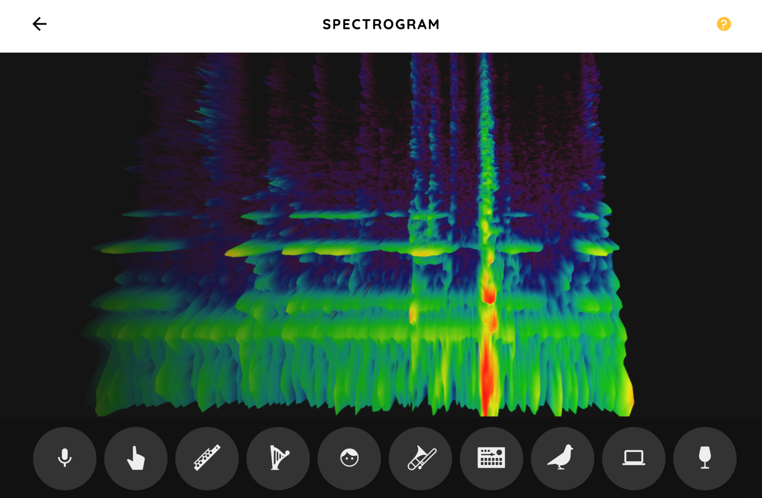
What does your spectrogram look like? Test it out here!
Notes:
https://musiclab.chromeexperiments.com/Spectrogram/

